Slide 1


Analysis of Lok Sabha Election 2024
Click Here for Tableau Dashboard File
By, Shngain Kupar Shullai

Slide 2
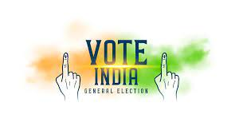
Project Description
The Lok Sabha Election 2024 is a significant event in India's democratic process, determining the composition of the lower house of Parliament.
This project aims to provide a comprehensive analysis of the election results, focusing on the performance of different political parties and their alliances.
Using Tableau, we will visualize the data to uncover insights about the distribution of seats, margin of victories, and overall status of the constituencies.

Slide 3
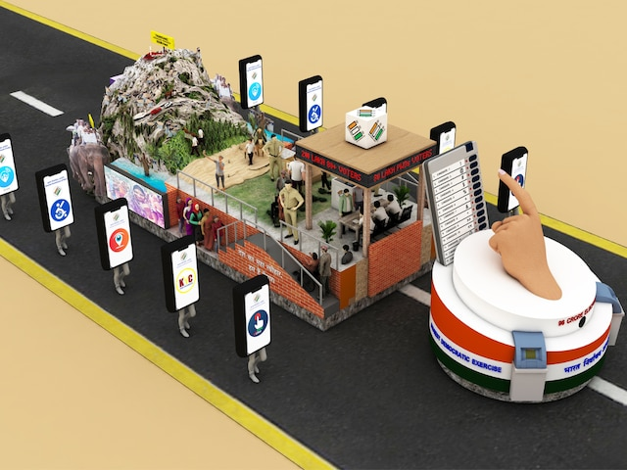
Approach
Data Integration: Combine election results with party alliance information to get a holistic view of the political landscape.
Data Cleaning and Preparation: Ensure data quality by addressing missing values, inconsistencies, and errors.
Visualize Election Results: Create visualizations to compare the performance of parties and alliances, highlighting key metrics such as seats won, margin of victories, and status of constituencies.
Identify Trends and Insights: Analyze the data to identify trends, patterns, and insights that can inform political strategies and public understanding.

Slide 4

Tech-Stack Used
Data Collection and Storage: Excel, CSV files
Data Cleaning and Preparation: Python and Excel
Data Analysis and Visualization: Tableau
Project Management and Collaboration: GitHub, Google Drive
Documentation and Reporting: Google Docs

Slide 5

After merging the two files, we now have a unified dataset named Election dataset 2024.csv (Multiple Connections)
No. of rows
543
Columns
12

Slide 6
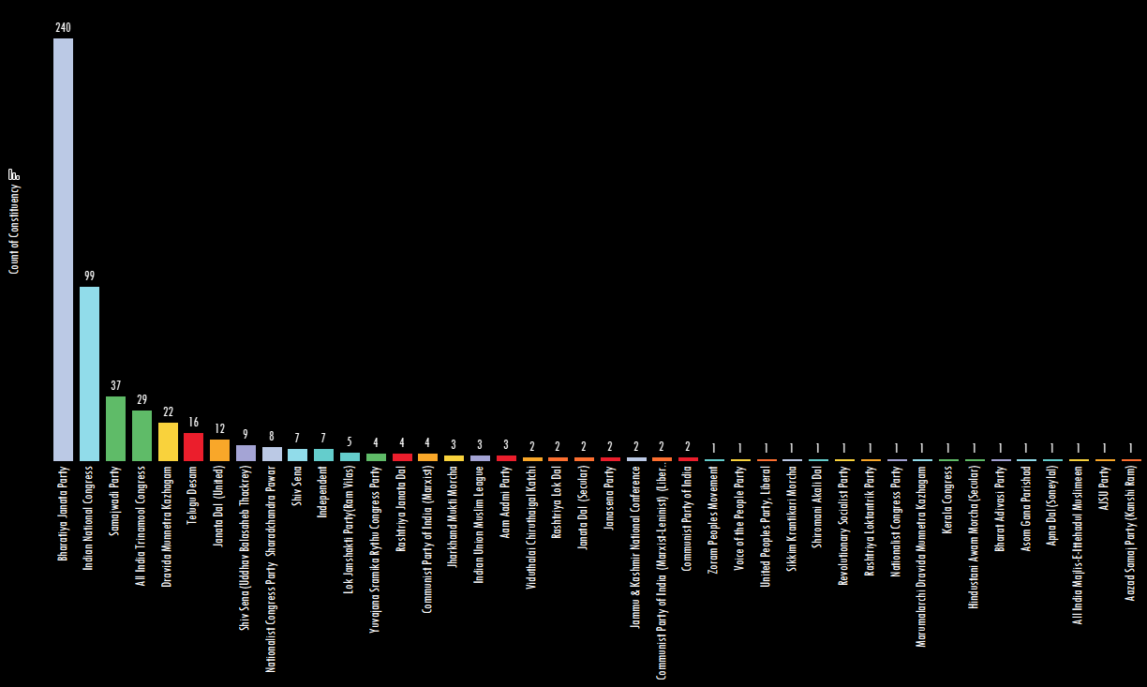


Overall Results: The total number of seats won by each party and alliance.
The Bharatiya Janata Party (BJP) is the leading party with a significant majority of 240 seats, showcasing its dominance in the current political landscape.
The Indian National Congress (INC) follows as the second-largest party with 99 seats, reflecting its substantial, though less dominant, presence.
Regional parties like the Dravida Munnetra Kazhagam (DMK) and the All India Trinamool Congress (AITC) also have a notable number of seats, 22 and 29 respectively, indicating their strong influence in specific states.
To visually represent this data, different colors are used for each party to distinguish them clearly.

Slide 7
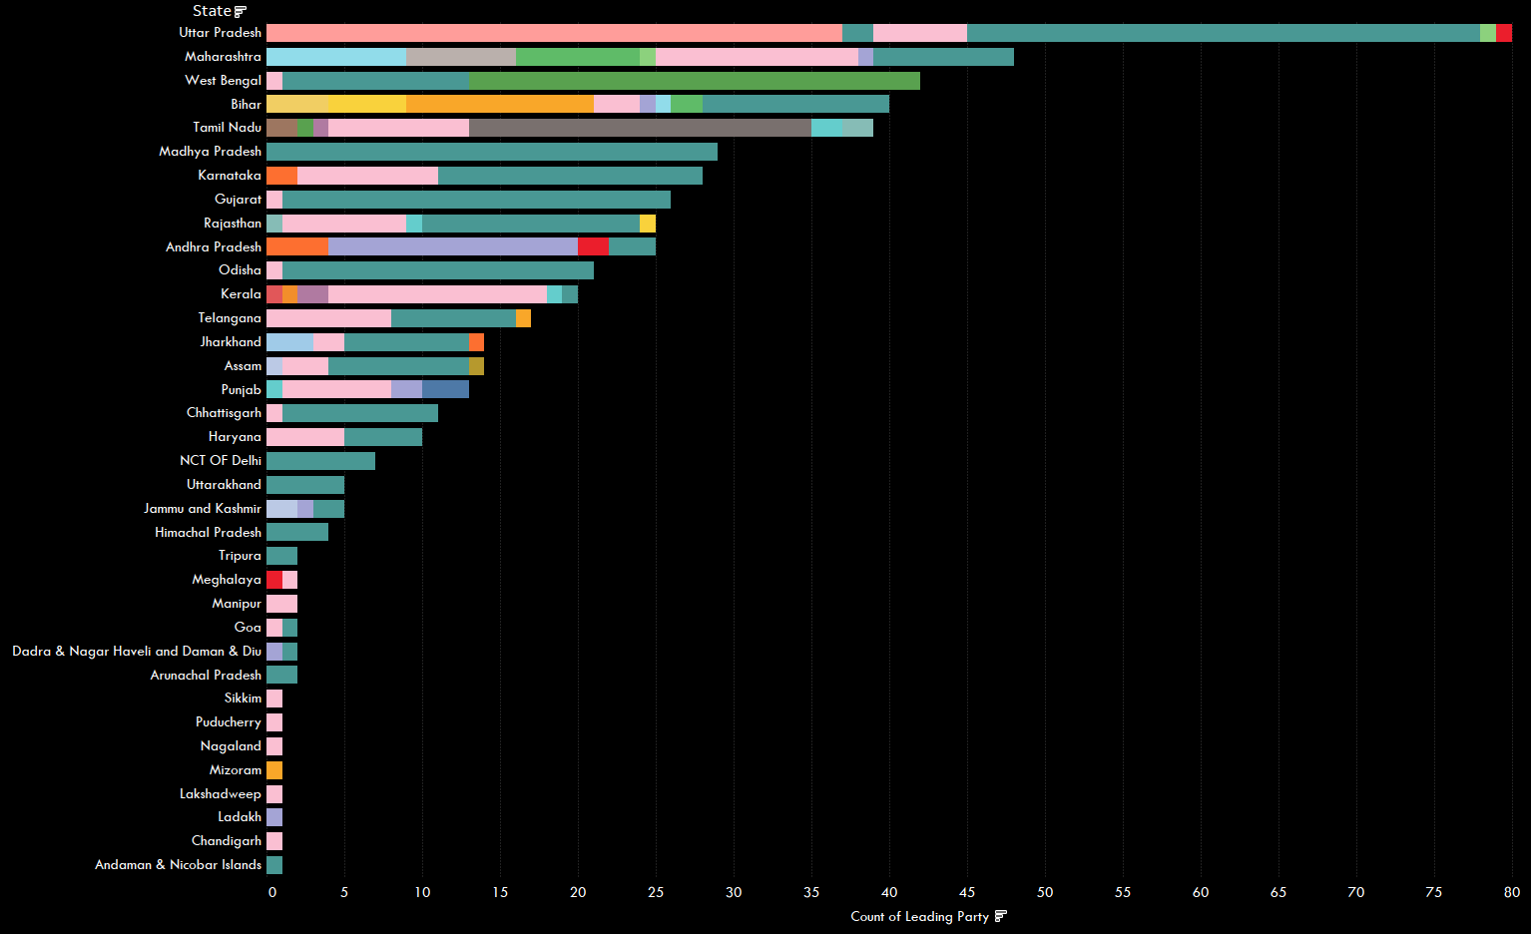


Andhra Pradesh shows a strong presence of Independent candidates, with numerous seats led by Independents, indicating a significant influence and preference for non-affiliated candidates in this region.
Maharashtra presents a mix of alliances, with both Independent and NDA candidates securing seats.
However, the NDA holds a notable presence, reflecting its strong organizational structure and voter base.
Uttar Pradesh is a battleground for the INDIA alliance, which leads in a majority of the seats.
The NDA also has a significant representation, highlighting the competitive political landscape in Uttar Pradesh.
The INDIA alliance is dominant in Tamil Nadu, leading in numerous seats. This suggests strong regional support for the coalition, possibly due to local political dynamics and campaign strategies.
West Bengal: The INDIA alliance has a substantial lead in West Bengal, securing a majority of the seats.
This indicates a strong regional foothold and effective voter outreach by the coalition, making it a key player in the
state's political scenario.
Visualize the performance of leading parties and alliances across different states.

Slide 8
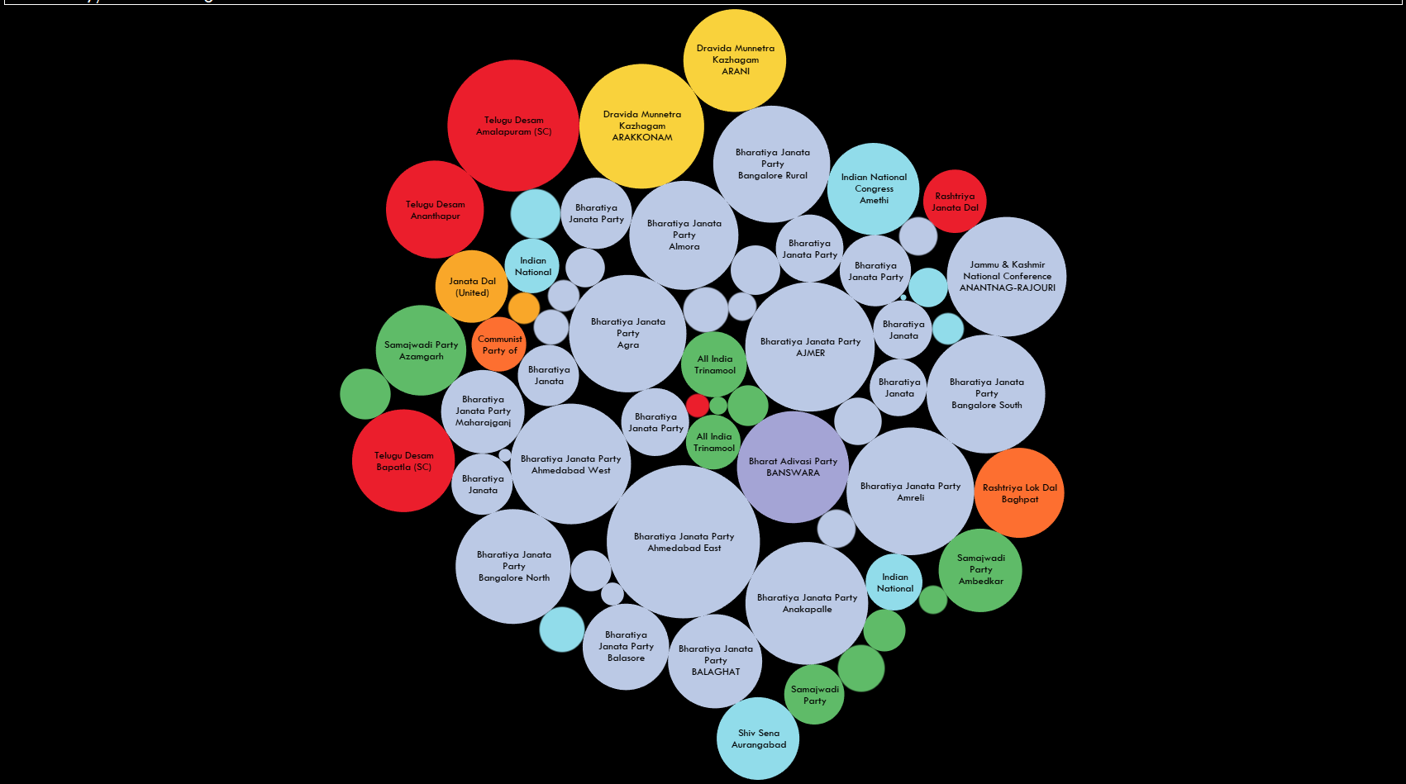
Visualize the
margin of victory/defeat
in various constituencies.
Telugu Desam showcased strong performances in Andhra Pradesh, particularly in the Amalapuram (SC) constituency, where they led Yuvajana Sramika Rythu Congress Party (YSRCP) by a substantial margin of 342,196 votes, indicating a solid voter base.
The largest margin of
victory was seen in the Arakkonam constituency, where the Dravida Munnetra Kazhagam (DMK) defeated the All India Anna Dravida Munnetra Kazhagam (AIADMK) by 306,559 votes, highlighting DMK's significant stronghold in this area.
The Indian National Congress (INC) had notable victories in constituencies like Amethi and Allahabad, with margins of 167,196 and 58,795 votes, respectively, demonstrating their competitive edge in Uttar Pradesh.
Bharatiya Janata Party (BJP) had several significant victories across various states, including a margin of 461,755 votes in Ahmedabad East and 271,294 votes in Agra, reflecting their widespread support and robust electoral presence.
A narrow margin of victory was observed in Attingal, where the Indian National Congress defeated the Communist Party of India (Marxist) by only 684 votes, underscoring the highly competitive nature of this constituency

Slide 9
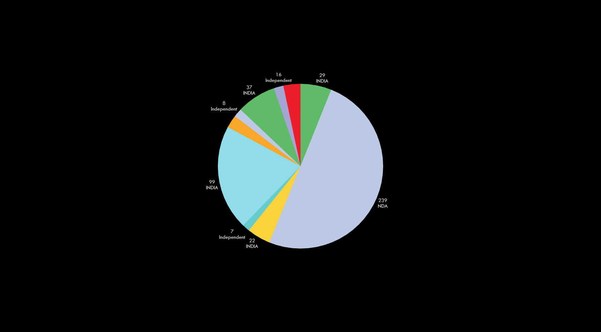
Performance of different parties and their respective alliances in terms of seats won.
The National Democratic Alliance (NDA), led by the Bharatiya Janata Party (BJP), has emerged as the most dominant force with a significant lead, securing 240 constituencies, almost entirely matching the margin of 239.
The Dravida Munnetra Kazhagam (DMK), also part of the INDIA alliance, has secured 22 seats, contributing to the alliance's overall competitive performance against the NDA.
The INDIA alliance, with parties like the Indian National Congress (INC) and the All India Trinamool Congress (AITC), has demonstrated a strong presence, winning 99 and 29 seats respectively, showing their consolidated strength in several regions.
Independent parties, while not part of any major alliance, have shown noteworthy success with Janata Dal (United), Nationalist Congress Party (Sharad Pawar), and Shiv Sena (Uddhav Balasaheb Thackeray) winning a combined total of 29 seats.
The Telugu Desam Party, although independent, has managed to secure 16 seats, indicating its substantial influence in its respective regions, comparable to some of the larger parties within the alliances.

Slide 10
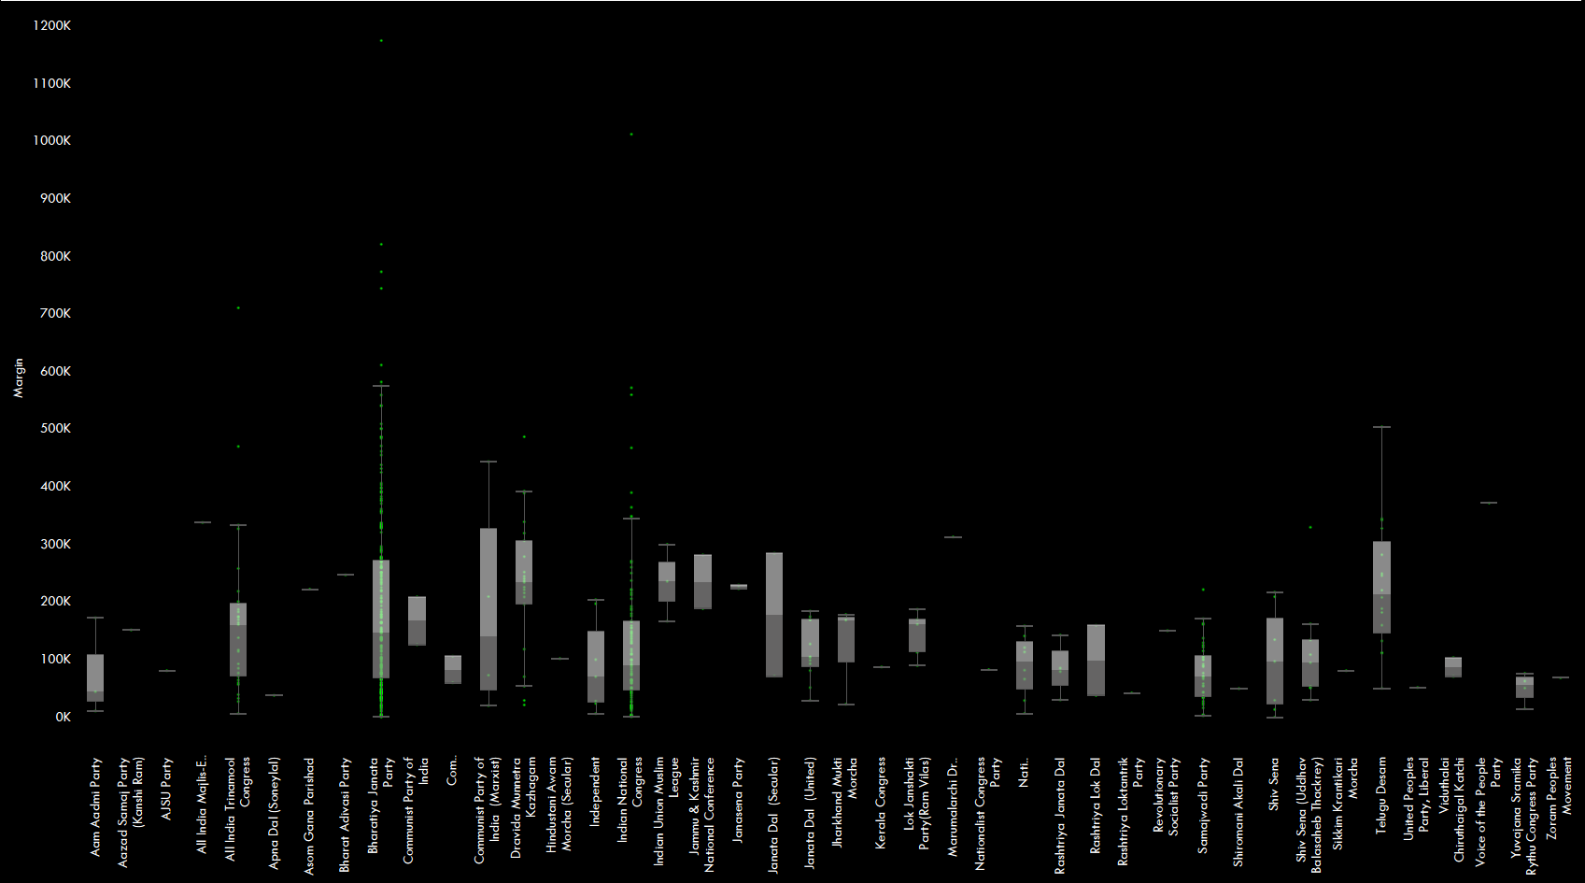
Performance of different parties and their respective alliances in terms of margins.
Based on the Lok Sabha Election 2024 analysis, the BJP has demonstrated significant dominance within the NDA alliance, securing a substantial number of seats across various regions.
Their performance indicates a strong voter base and effective campaign strategies, reflecting widespread support among constituents.
Overall, the election results underscore the BJP's continued electoral prowess within the NDA alliance, while also reflecting competitive dynamics and voter pluralism across India.

Slide 11
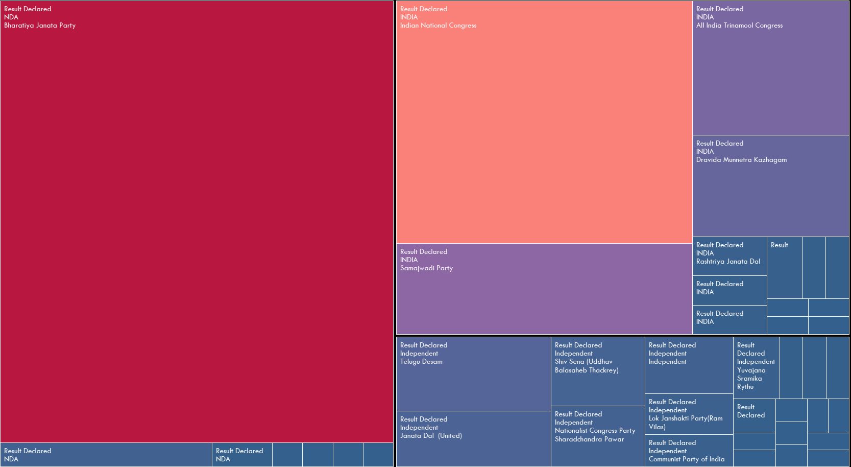
Performance of different parties and their respective alliances in terms of their status.
Regional parties like the Shiv Sena, Samajwadi Party, and Dravida Munnetra Kazhagam (DMK) have also secured multiple constituency wins, underscoring their strong regional influence.
The Indian National Congress (INC) follows with results declared in 99 constituencies, indicating a considerable but comparatively lower presence.
The alliance dynamics show BJP's alliance with the National Democratic Alliance (NDA) bolstering its nationwide footprint, while the INC-led alliances and regional coalitions like the United Progressive Alliance (UPA) maintain a competitive edge in certain regions.
Overall, these results highlight a diverse political landscape with regional parties playing crucial roles alongside major national entities like BJP and INC.

Slide 12
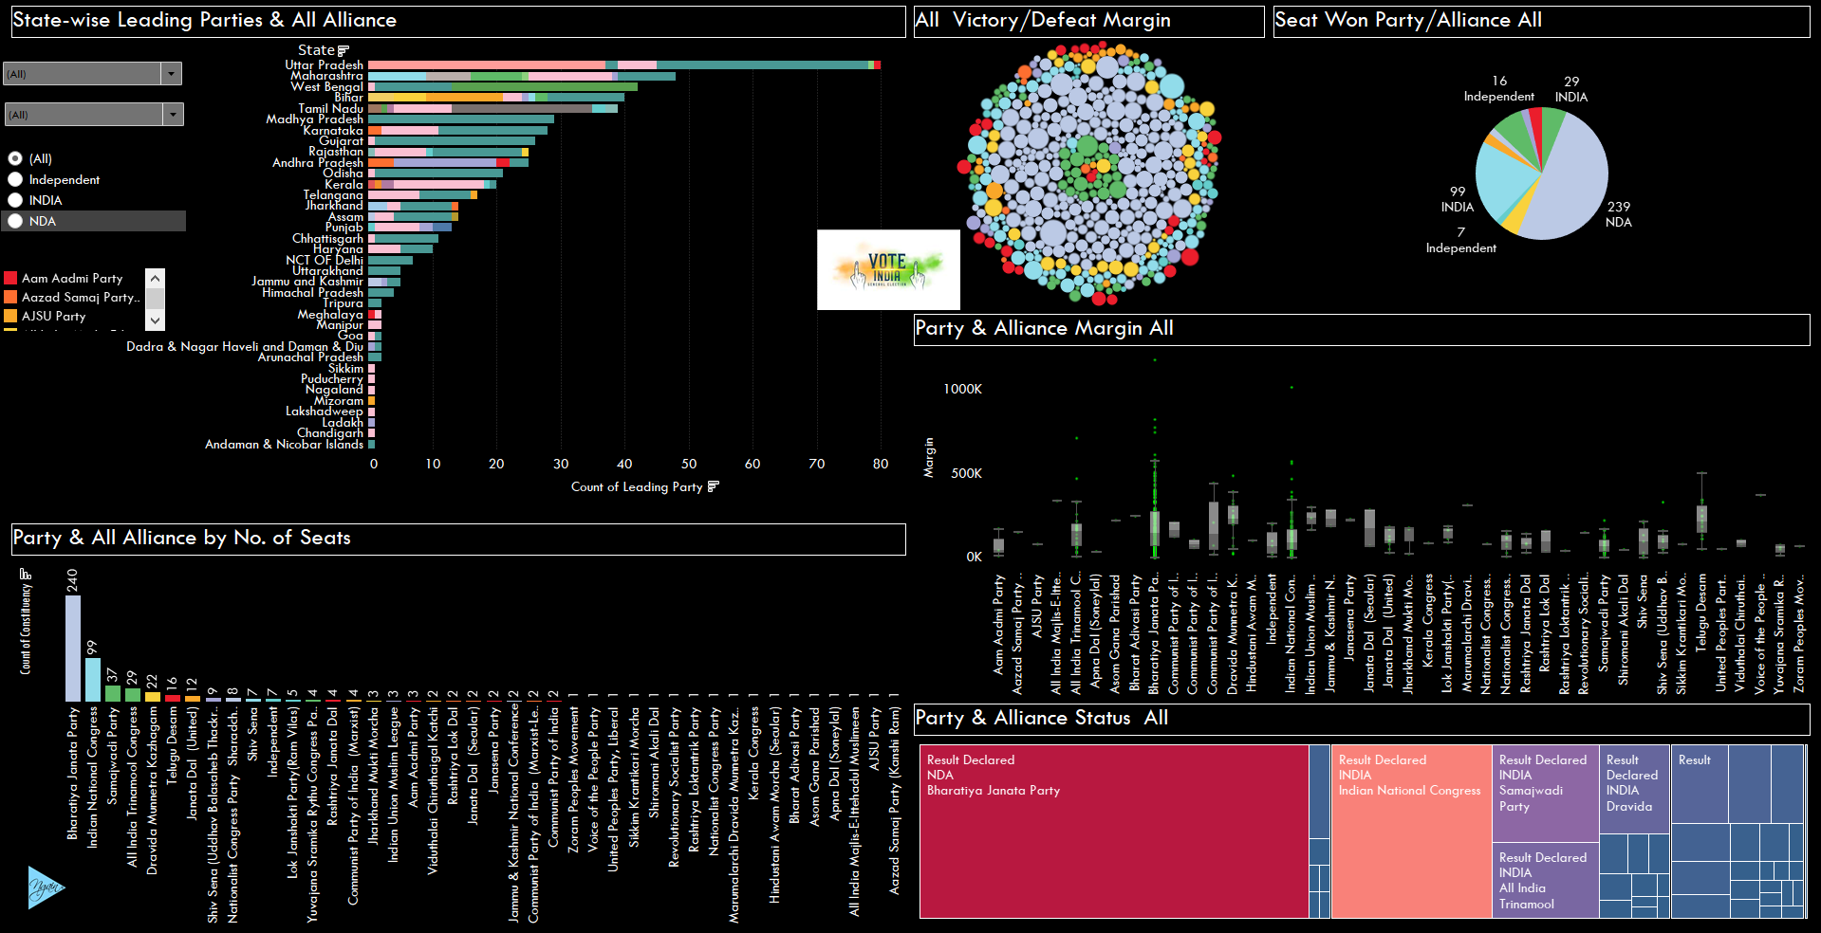
Interactive Dashboard
Click Here for the Dashboard File

Slide 13

Insights:
BJP, as part of the NDA, has secured the highest number of constituencies, demonstrating a robust nationwide support base.
INC, part of the INDIA alliance, is the second-highest in terms of constituency count, indicating strong opposition and competitive performance in several regions.
The analysis shows significant regional variations in support, with certain parties and alliances performing better in specific states or regions.
The margin of victory in many constituencies for BJP is substantial, suggesting a strong mandate. However, there are also constituencies with narrow victory margins, indicating areas where competition is fierce.
Independent candidates have won a notable number of constituencies, particularly in regions where major parties have a weaker presence, indicating voter preference for non-aligned candidates in these areas.
The performance of alliances like NDA and INDIA shows the importance of coalition politics.
The strength of these alliances in securing seats highlights their strategic significance.
Several constituencies have shown a swing in party preference compared to previous elections, indicating changing voter dynamics and potential areas for focus.

Slide 14
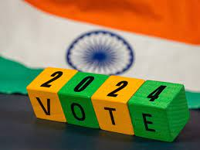
Preparation for the Next Five Years
NDA will focus on implementing impactful policies, strengthening regional presence, and maintaining alliance unity.
Effective governance, economic reforms, and public welfare programs will be prioritized to solidify voter trust.
Modi might adapt his strategy to emphasize grassroots connection, aggressive reforms, digital governance, and global diplomacy.
The NDA will demonstrate faith through transparent communication, accountability measures, and visible infrastructure projects.
The INDIA alliance will present a unified front, target key states, and increase grassroots campaigning to gain more seats. They will develop a common minimum program, carefully select candidates, and leverage media effectively.
Independents and smaller parties will focus on regional issues, form local alliances, and campaign on specific concerns. They will engage directly with communities, maintain a clean image, and use innovative campaigning techniques.
Advocating for local policy needs, such as agricultural support and infrastructure, will help them attract voter support. This comprehensive approach aims to secure long-term political success and voter confidence.
Thank You

